Slide 1

Playing Card Detection and Identification
Dan Snyder

Slide 2
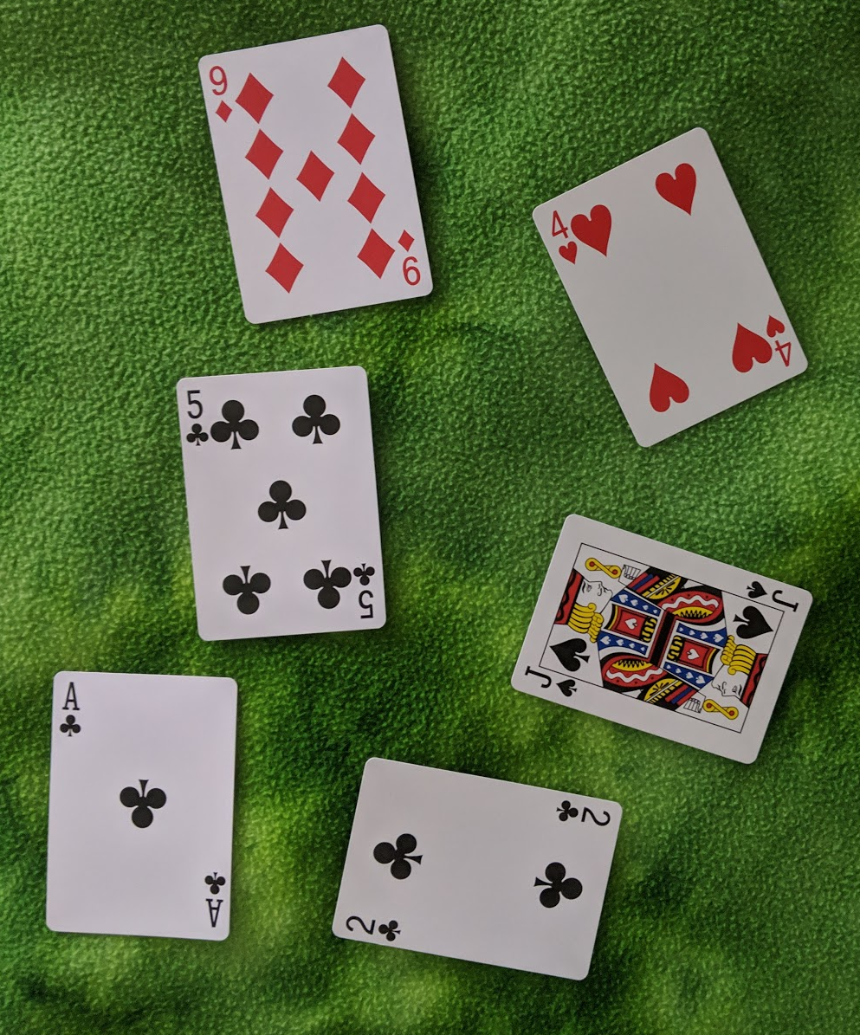
Goal
Detect and Identify all playing cards in an image
9D
4H
5C
JS
AC
2C

Slide 3
Let’s Use Sift

Slide 4
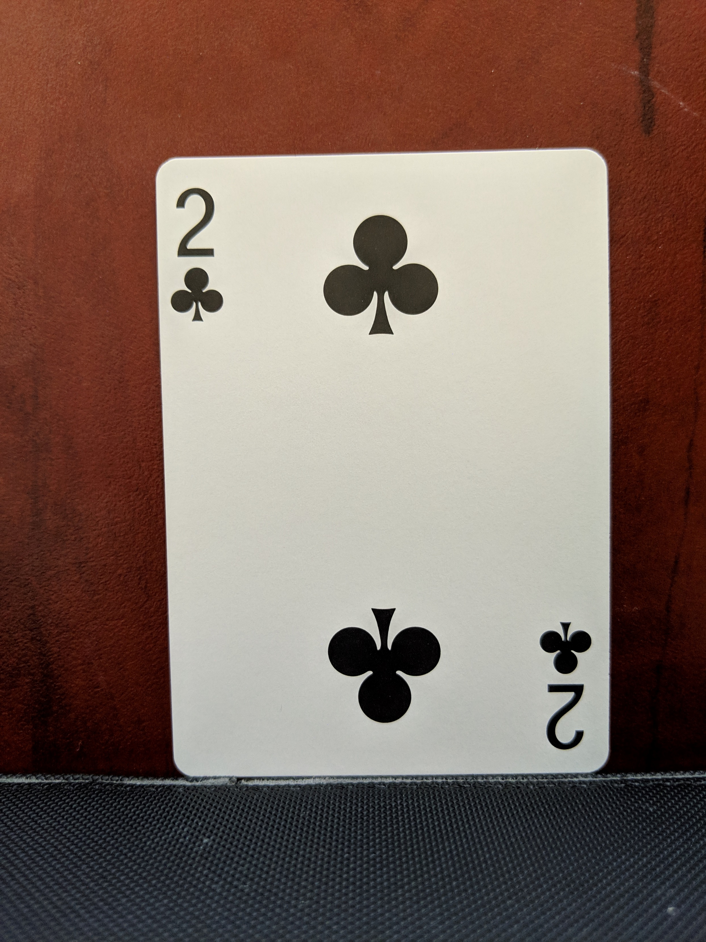
Why Sift
Rotation invariance
Scale invariance
Robust to lighting

Slide 5
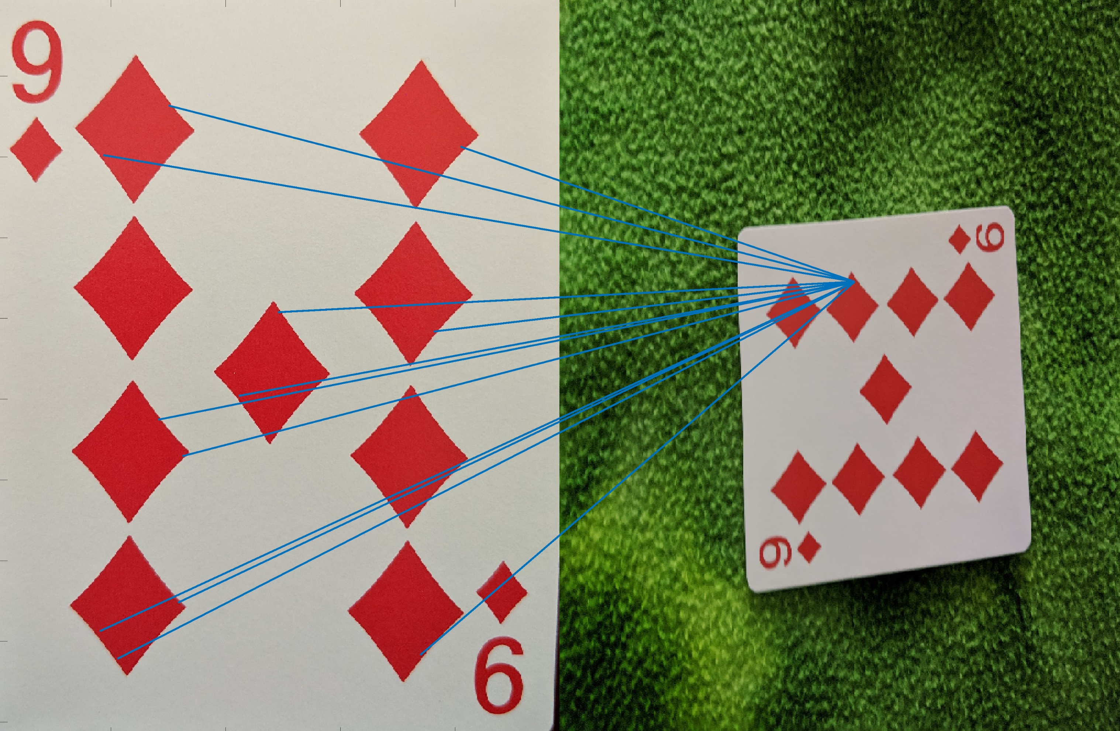
Results:
Not good

Slide 6
Why Sift Failed
Rotation invariant features

Slide 8
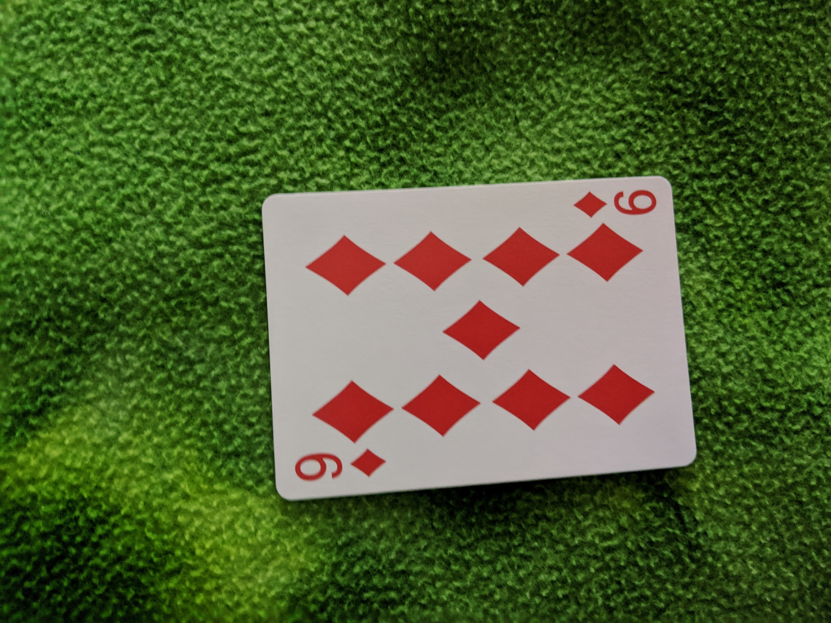
Approach #2

Slide 9
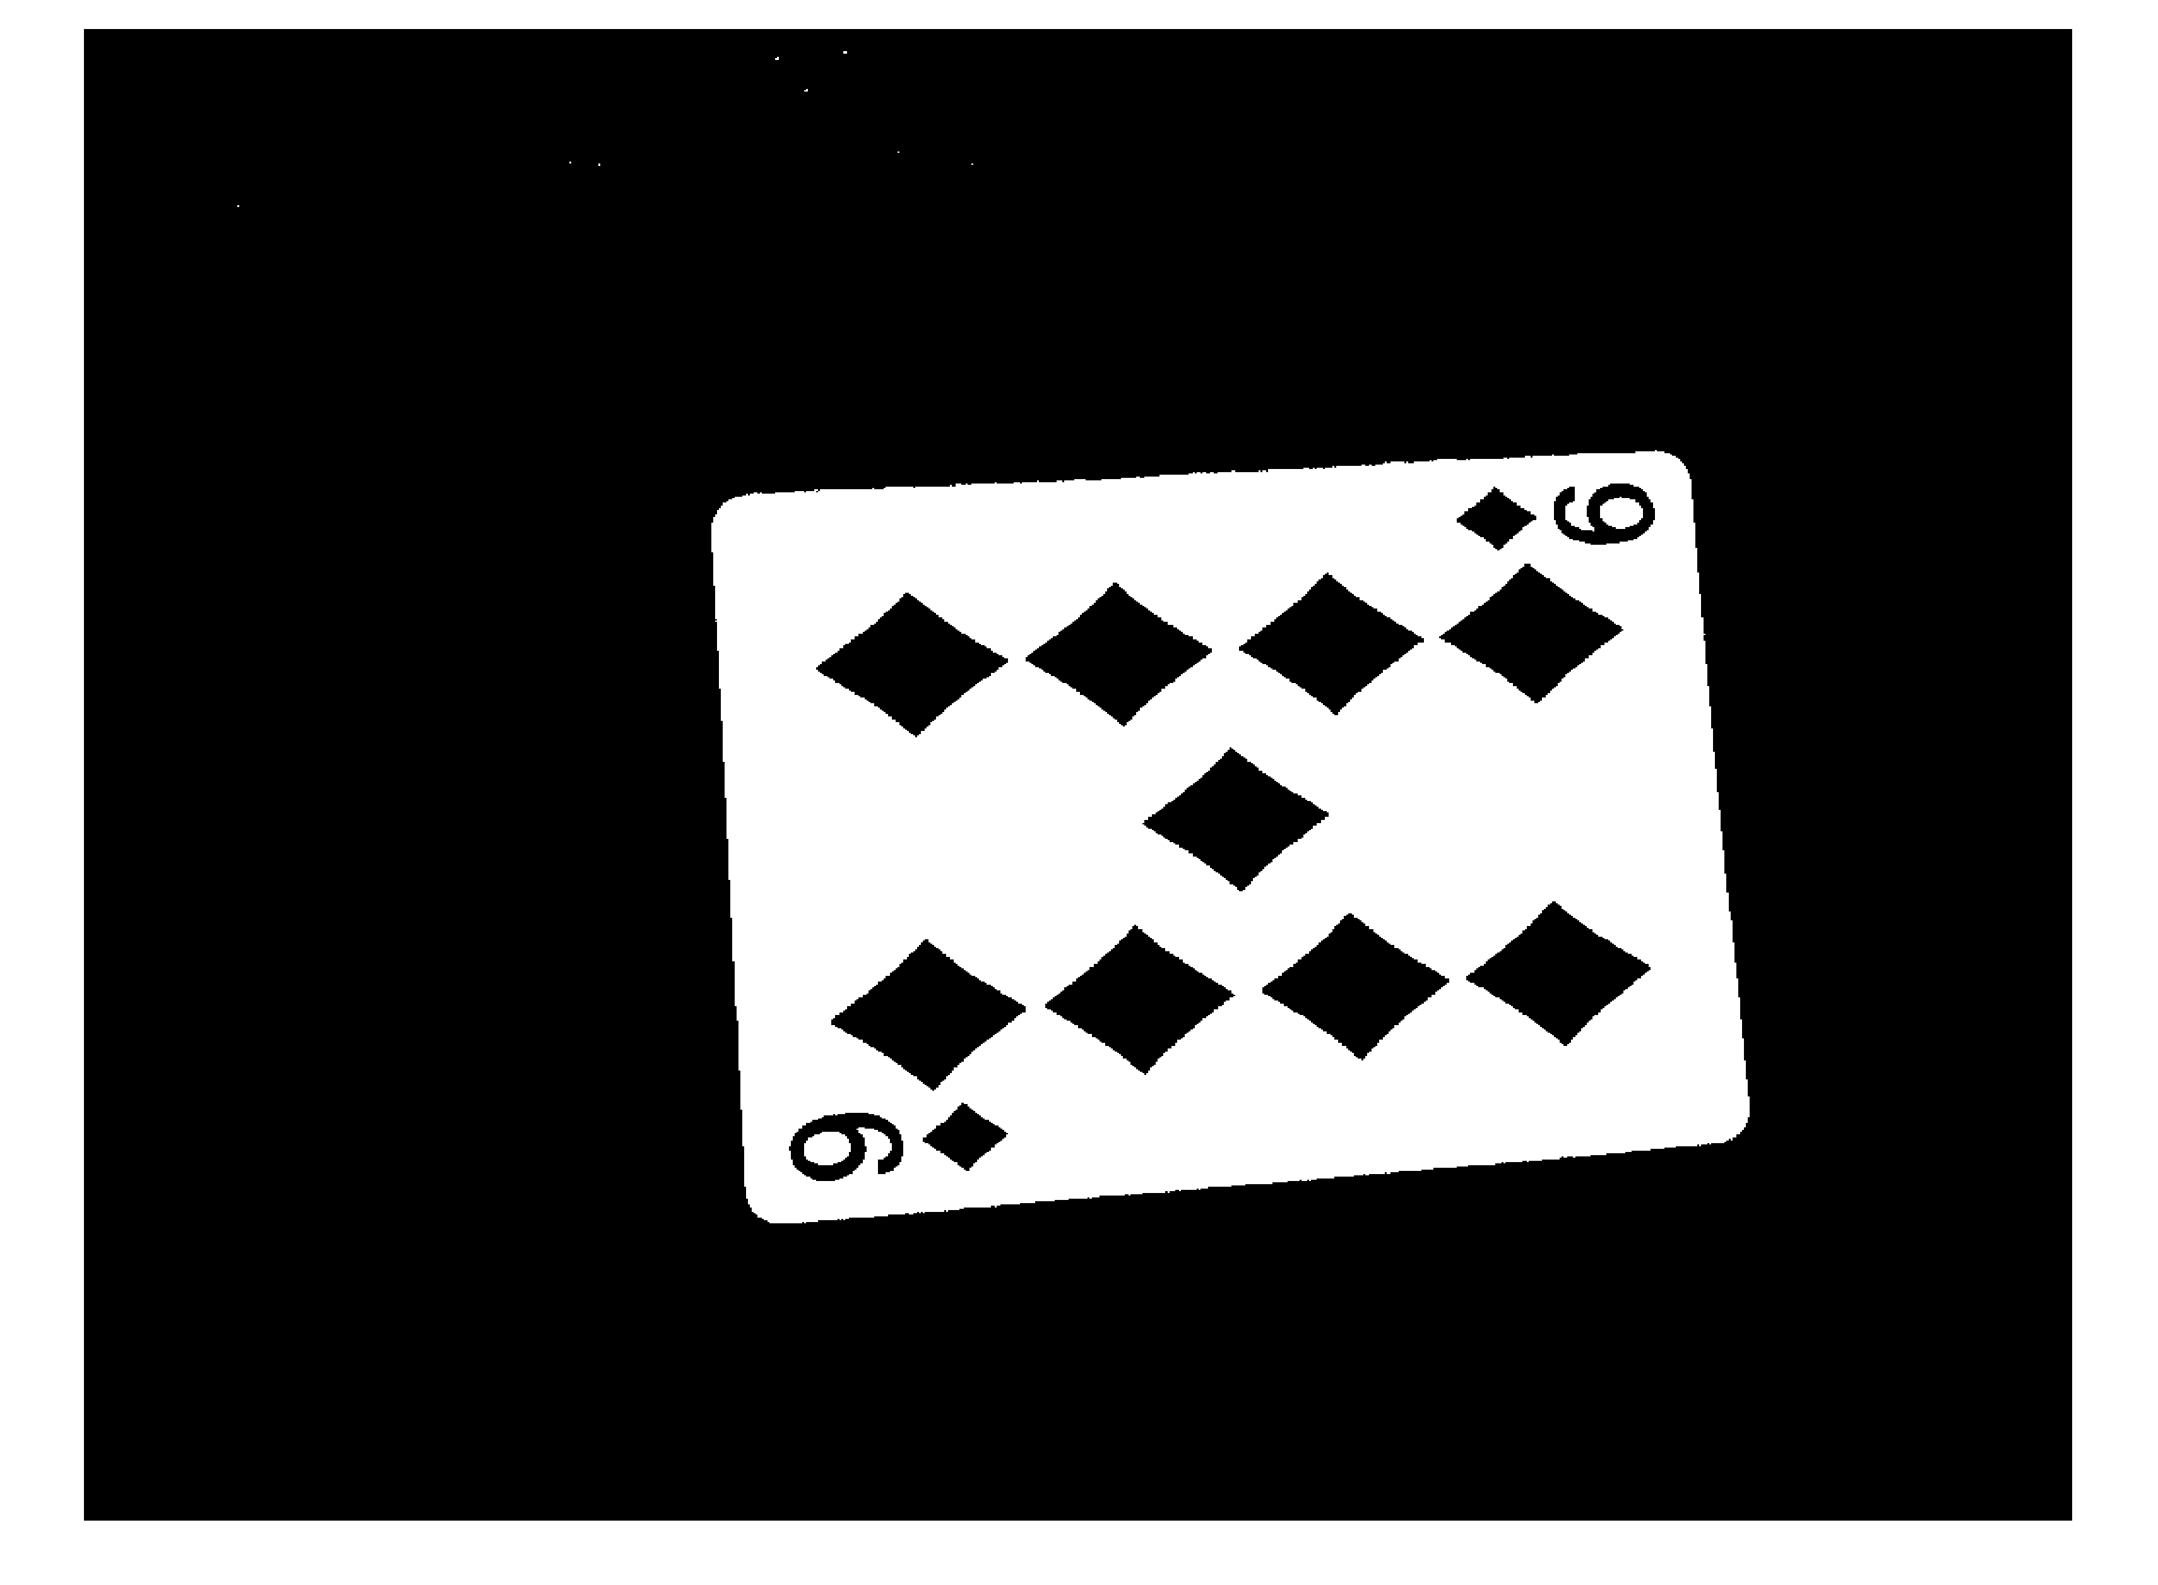
Approach #2
Threshold

Slide 10
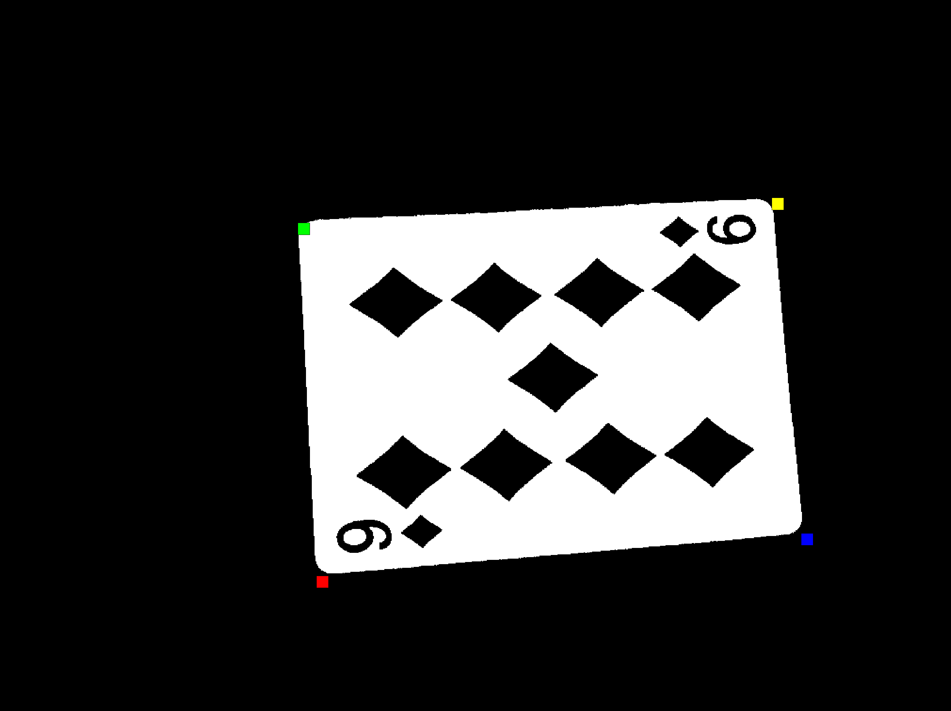
Approach #2
Threshold
Find & Arrange Corners

Slide 11
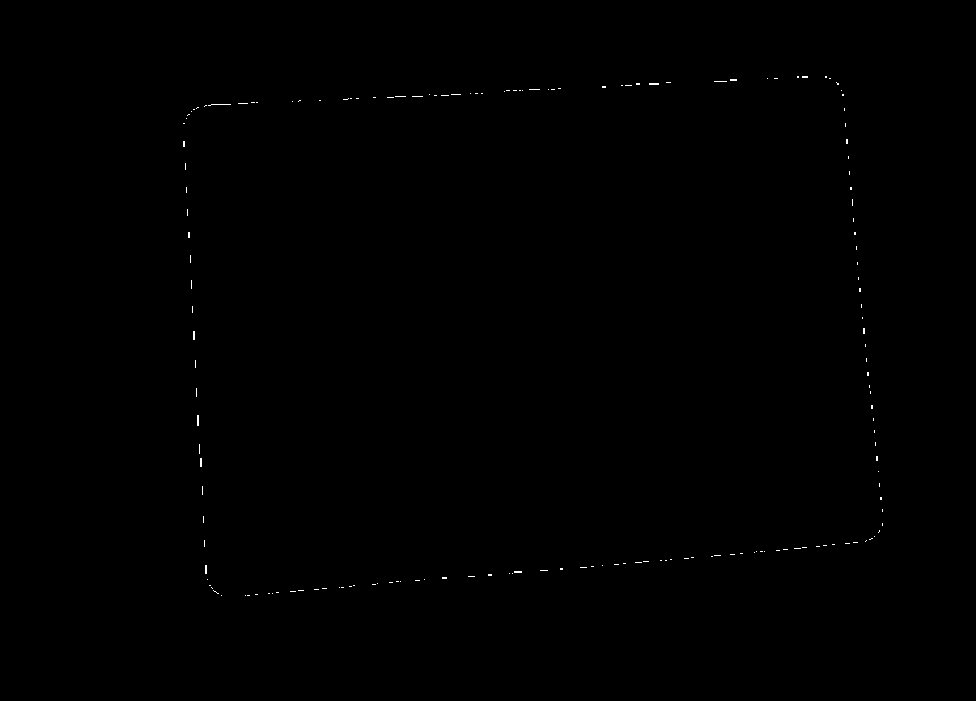
Find and Arrange Corners
Find edges

Slide 12
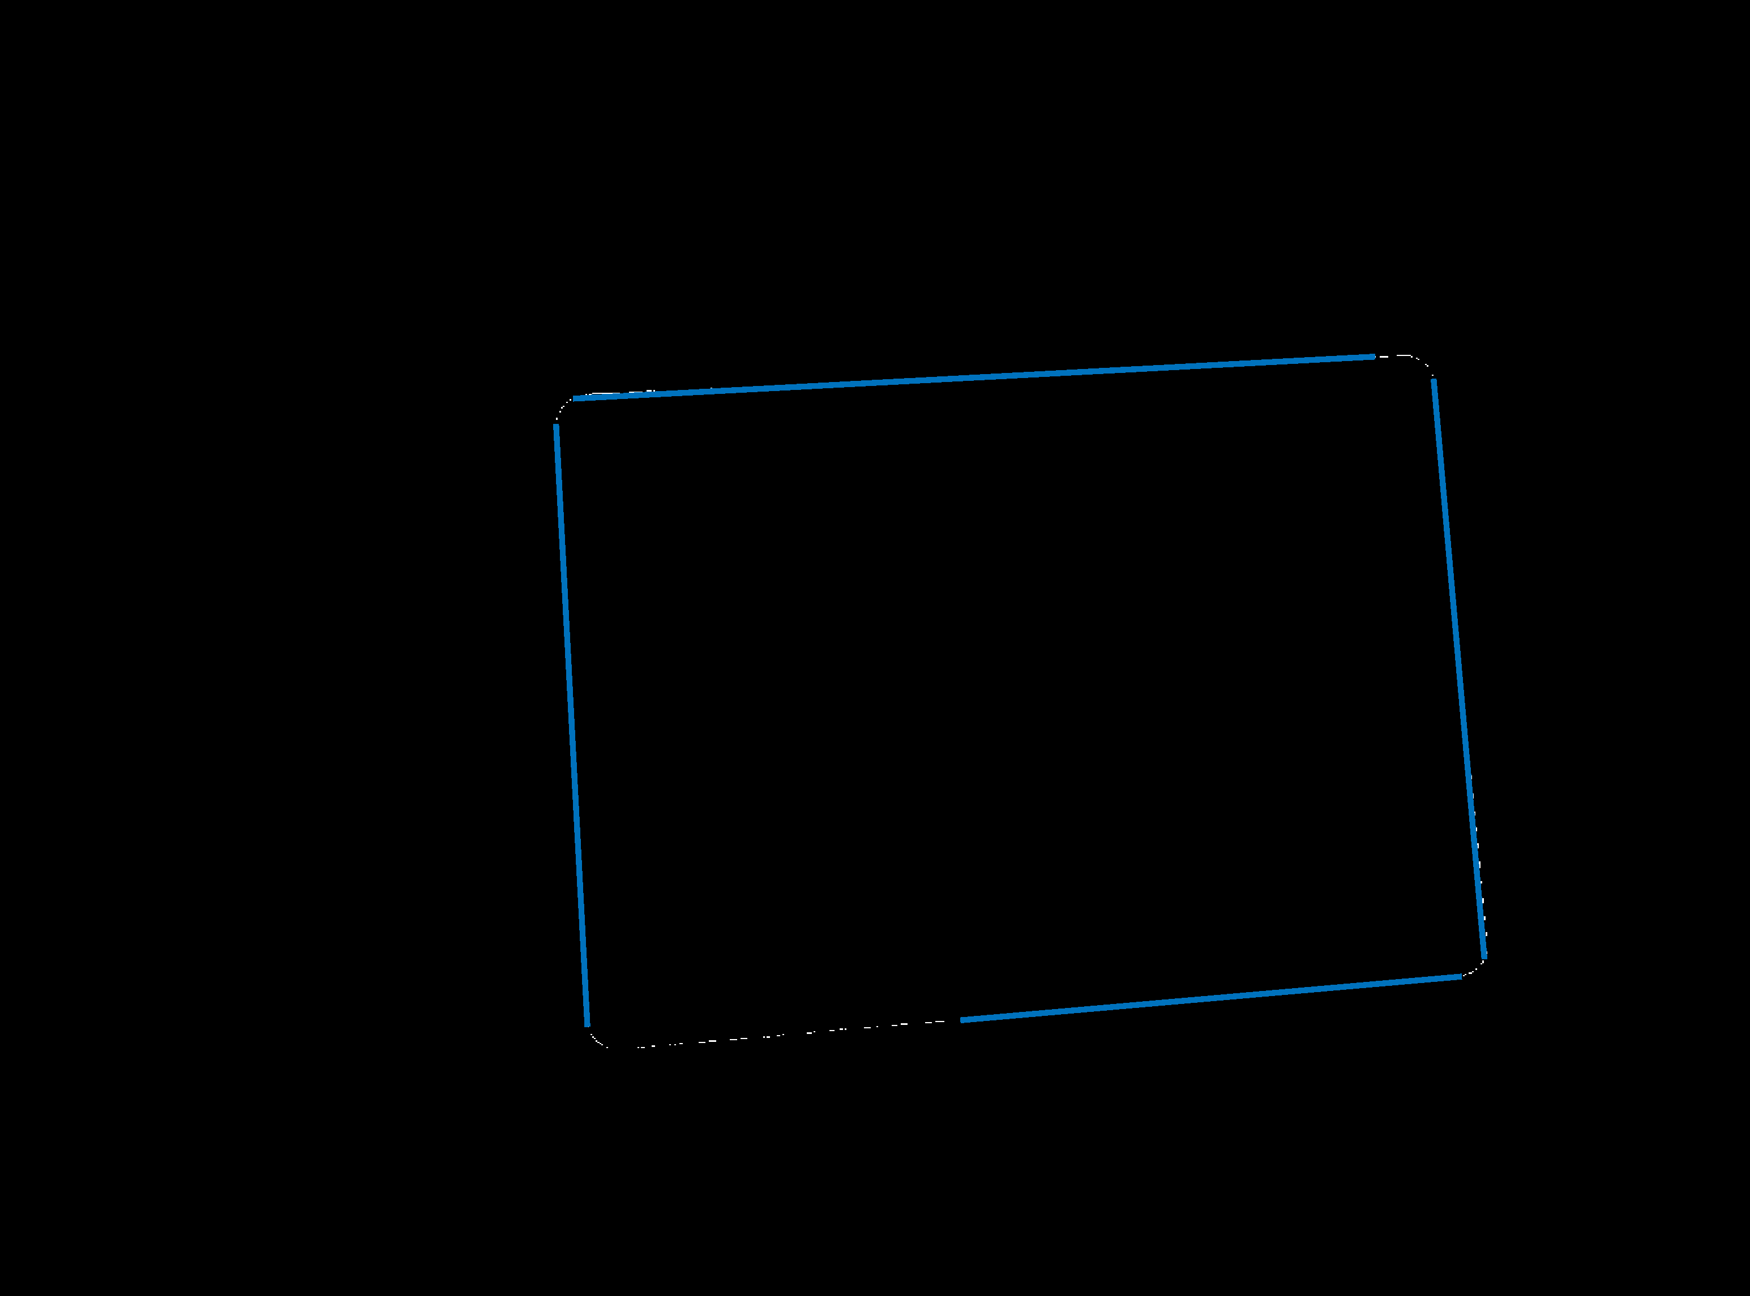
Find and Arrange Corners
Apply Hough Transform

Slide 13

Find and Arrange Corners
Intersections of lines are corners

Slide 14
Find and Arrange Corners
Identify dark region closest to a corner

Slide 15
Find and Arrange Corners
Mark closest corner as first corner
Go around from there

Slide 16
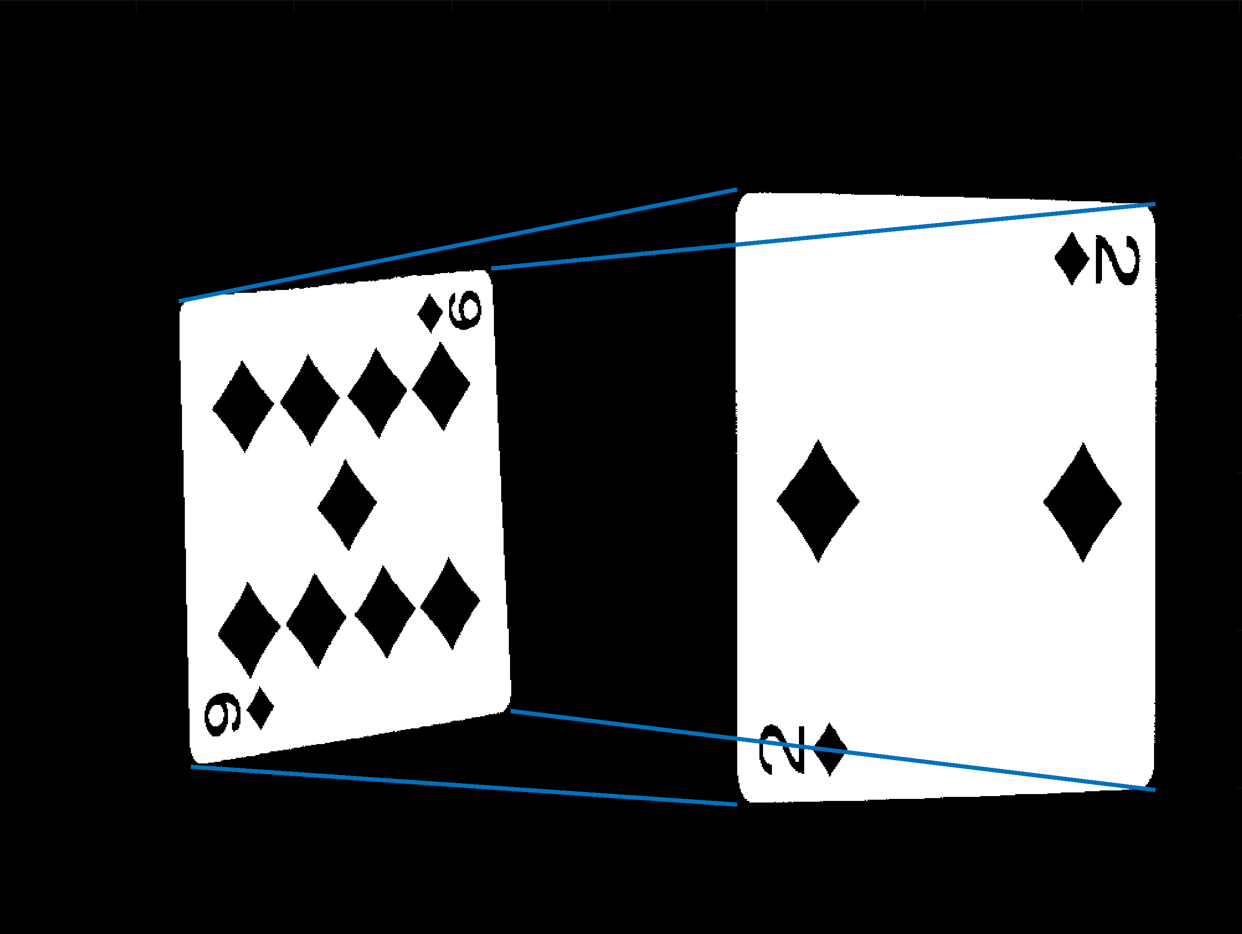
Approach #2
Threshold
Find & Arrange Corners
Create Transform
SSD between templates

Slide 17
Results
5/6 correctly identified
9D
4H
5C
JS
AD
2C

Slide 18
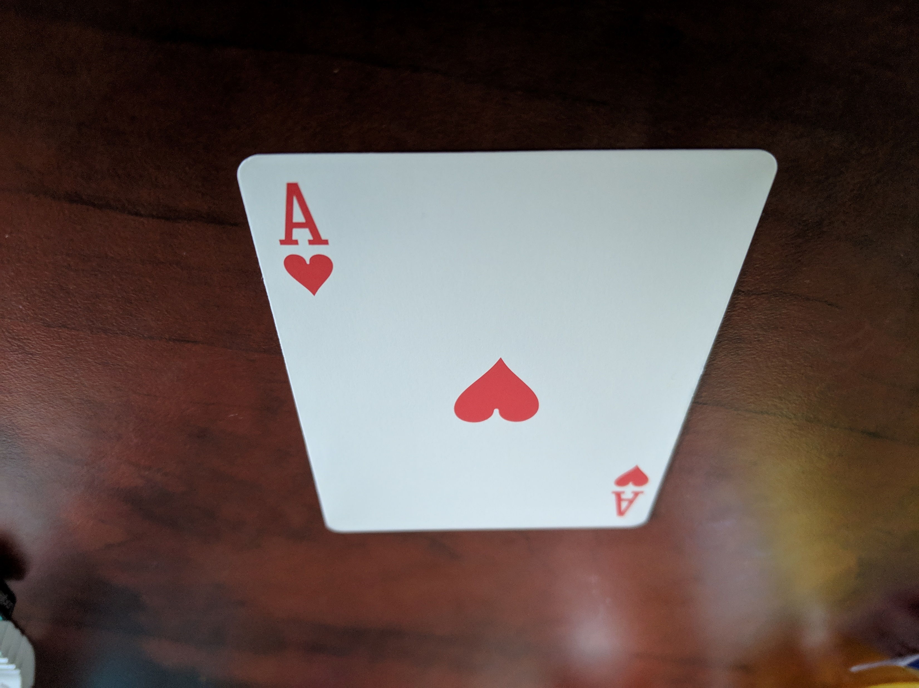
Next Step
Test on extreme perspective
Tune for better performance

